Slide 1
CHATBOT
NOOB ENTITY
M Jaipal-9919004177
H Nikhil Reddy-9919004106
S Likhil Srinivas-9919004269
S V Nagendra -9919004270

Slide 2
INTRODUCTION
Chatbot applications interacts between people and services, enhancing customer experience.
There are two different tasks at the core of a chatbot:
1. User Request Analysis
2. Returning the response
Regardless of the kind of approach and the platform, human intervention is crucial in configuring, training and optimizing the chatbot system

Slide 3
User Request Analysis
This is the first task that a chatbot performs. It analyses the user’s request to identify the user intent and to extract relevant entities.
2. Returning the response
Once the user’s intent has been identified, the chatbot must provide the most appropriate response for the user’s request.
The answer may be:
1. A generic and predefined text
2. A text retrieved from a knowledge base that contains different answers.
3. A contextualized piece of information based on data the user has provided.

Slide 4
METHODOLOGY
Importing Libraries
Reading the Corpus
Text Processing
Defining greeting Functions
Response Generation
Defining Conversation Start/End Protocols

Slide 5
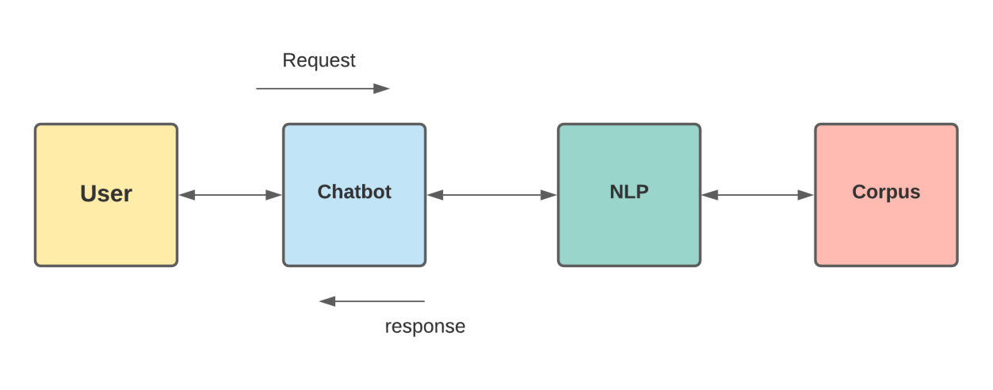
ARCHITECTURE

Slide 6

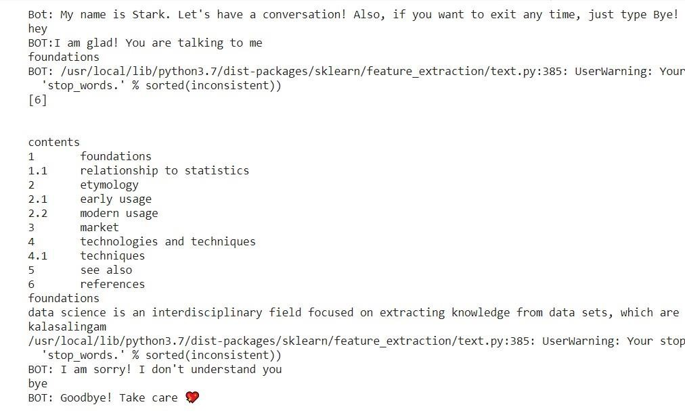
EXECUTION
Colab Link:
https://colab.research.google.com/drive/1WfoDECELc1RjtoTvlyC3GnaeB6GBWLvr?usp=sharing

Slide 7
CONCLUSION
From my perspective, chatbots or smart assistants with artificial intelligence are dramatically changing businesses.
Chatbots can reach out to a large audience on messaging apps and be more effective than humans.
There is a wide range of chatbot building platforms that are available for various enterprises, such as e-commerce, retail, banking, leisure, travel, healthcare, and so on.
This chatbot can answer queries in the textual user input.
At last, we can conclude that our chatbot helps students to get some basic knowledge on any particular topic.

